Slide 1


Code copy and defect detection
Student: Zijie Shen
Supervisor: Simon Lock
University of Bristol
Computer Science

Slide 2

introduce
Academic integrity has always been a basic rule that students need to abide by. In our studies, the originality of code is increasingly valued. However, the existing code duplication checking tools on the market often have problems such as low efficiency and cumbersome use. Therefore, I developed this tool to provide a more accurate and faster solution and improve the efficiency of code evaluation.
This tool uses new technology to jointly detect code using basic code duplication detection and new code defect detection. It can effectively identify various types of similarities, including direct copying, slight modifications and structural similarities, which greatly Improve efficiency.

Slide 3

specific problems solved
Problems with code duplication checking tools currently on the market:
1. The installation is too complicated, and the operation is difficult
2. Some require fees, or you will not be able to use all functions.
3.Cannot open after downloading
4. Low efficiency
5. The accuracy of recognition is low and completely unrecognizable.
The function I need to implement
Simple installation tutorial
High efficiency and high accuracy
Detection can be achieved without the need for an Internet connection

Slide 4
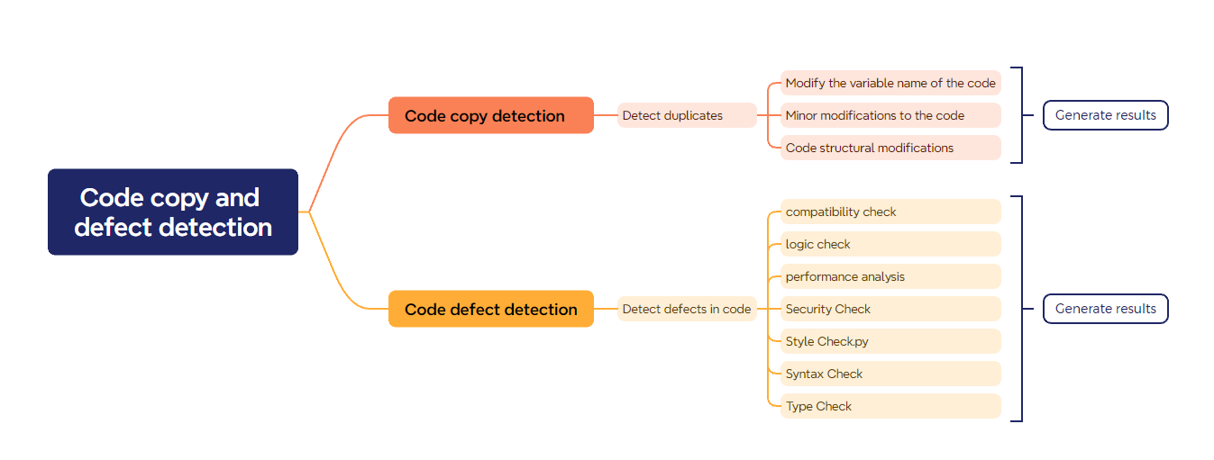
The main functions of code duplication checking tools

Slide 5

Normal human code:
The code is concise and accurate
logical coherence
Simple code structure
Plagiarism problem code:
Many variable names will be modified
Add more variables and structures
Logic confusion
complex structure

Slide 6
development environment -python Technology stack key algorithms

Slide 7
Show example

Slide 8
summary

Slide 9
Plan later

